Slide 1
Predicting Home Loan Borrower Default
Final Project / Kaggle Competition
George Jiang, Kineret Stanley and John Woolley
W207 - Applied Machine Learning as taught by Uri Schonfeld
University of California, Berkeley - Masters in Data Science Program

Slide 2

Kaggle Competition
Home Credit Default Risk
https://www.kaggle.com/c/home-credit-default-risk/overview
Sponsor/Data Provider: Home Credit Group (A lending institution)
Notes:
3 year old Kaggle competition. Fairly straightforward -- predict which applicants will default on a home credit loan. We had expertise in finance and consumer lending, and wanted to spend our time playing with features and a few models.

Slide 3

Motivation: Assessing Lending Risk
Preservation of income and capital
Although mortgages are secured by real estate, there is still a real risk of economic loss if house prices fall (see 2008)
Legal and transaction fees can be large and foreclosure process can be protracted
Benefits for consumers
Equity: Fairness in impartial decision making
Decrease refusals of worthy borrowers
If consumers get unaffordable loans, it can lead to foreclosure and long term damage to credit

Slide 4
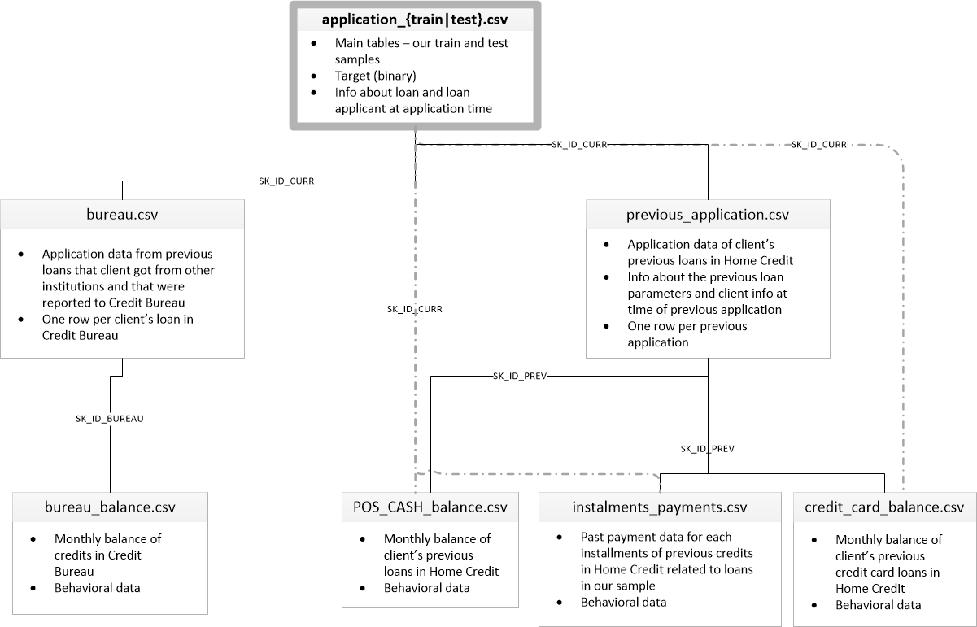
Feature Complexity
Notes:
The complexity of the features is what drew us to this Kaggle challenge. We all had worked within finance roles at one point in our lives, and this felt like a good opportunity for us to acquaint ourselves with the difficulties and challenges of feature wrangling. From feature generation, imputation, selection, etc. we had a lot of opportunity to play with different models and learn some valuable lessons.
We only got to using three of them seriously for feature extraction and engineering.
The primary dataset contained information about the current loan...everything from how many children the applicant has to how many garages the residence has.
Bureau data - this is data from one or more of the credit agencies, which collect data on us all. When we apply for any type of credit, a company will run a hard (or possibly soft) pull of your credit history; including, but not limited to your current debt levels..past debt etc.
Previous application data contains proprietary information (not just from the Credit bureau) about an applicant’s previous applications. It was complicated by the fact that all types of consumer credit (including the kind you may use to buy a cell phone) were included.

Slide 5
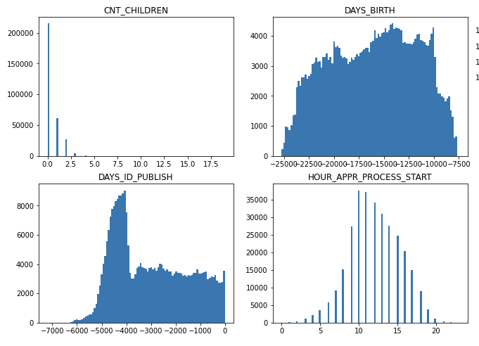
Data Summary: Exploratory Data Analysis
Current Application Data Summary:
307,511 observations
120 features not counting target and unique borrower id
Data Types:
16 string types (Categorical)
39 integer types
65 float types
Cross Sectional base dataset
~8% positive (imbalanced classes)
~30% missing data
Notes:
Categorical variables were particularly interesting. Some like organization type which only applied to companies, had 57 unique elements.
Some numeric variables were simply flags, but we weren’t told what they were (e.g., FLAG DOCUMENT 9). And these were the most correlated with our TARGET (outcome variable).
We split the data float/numeric/categorical when we visualized to help us hone in on differences, and to identify anomalies.

Slide 6
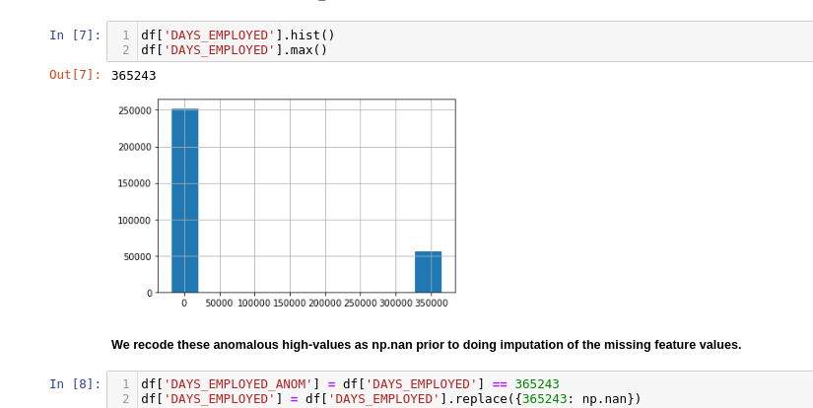
Anomaly: Exploratory Data Analysis (II)
High coded values in ‘DAYS_EMPLOYED’ variable
Counts days employed, but is a negative number
Shouldn’t be positive values
Positive values actually have a lower conditional default rate
Credit: Will Koehrsen - Start Here: A Gentle Introduction for pointing it out

Slide 7
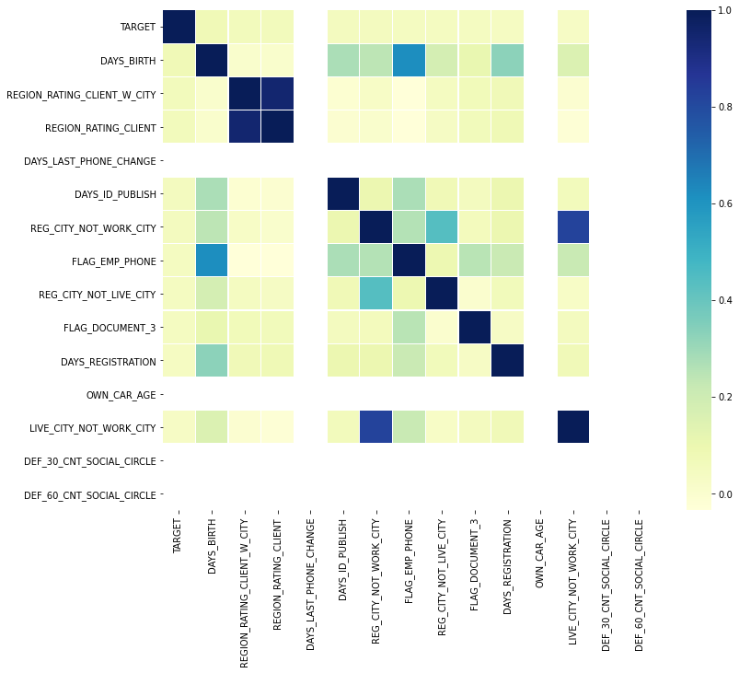
Correlation: Exploratory Data Analysis (III)
Notes:
The good news is we had little to worry about regarding multicollinearity. The bad news is that we couldn’t easily identify features that were most / least correlated with TARGET.

Slide 8
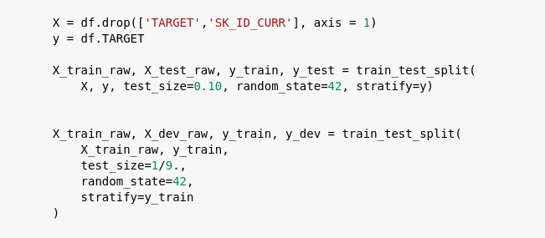
Dataset: Splitting into Sets
Train: 80%
246008 observations
Dev: 10%
30751 observations
Test: 10%
30752 observations
Notes:
The original Kaggle competition dataset came with a training dataset and a test dataset without labels. Because the latter is practically useless to us since we do not know the correct labels, we need to segment the dataset ourselves. We chose 80-10-10 because we felt that the data set was sufficiently large to give random-sample like results on the test dataset by only allocating 10% of the total observations, taking out an equal amount for the dev set and leaving us 80% of the observations for training.

Slide 9
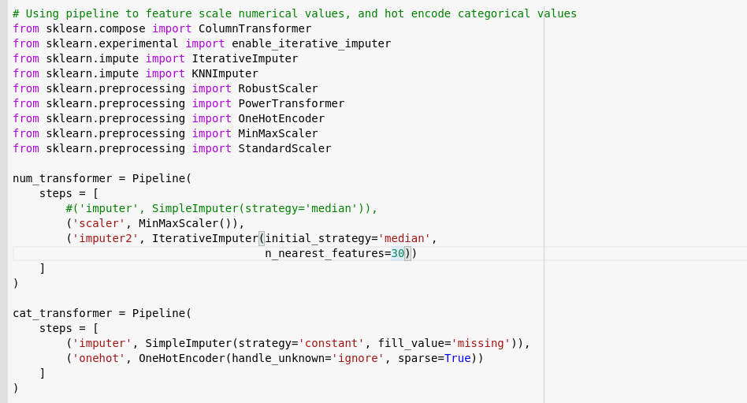
Dataset: Preprocessing
Numbers:
MinMax Scaler
Iterative Imputer
Categoricals:
‘Missing’ fill
One-hot encoding
Notes:
We tried multiple different preprocessing pipelines and ultimately settled on a minmax scaler and iterpative imputation for numerical values and simply filling missing categoricals with ‘missing’ before doing a one-hot encoding. Iterative Imputer works through the columns with missing values in order of the most missing values to the least missing values and estimates the missing value based on the values of the 30 nearest features. The algorithm can take quite a while to run based on the compute available. On Colab it took 40+ minutes. On an AMD 3800X CPU it took about 15 minutes.

Slide 10
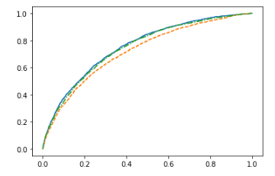
Evaluating Model Performance: AUC
For our single-metric of performance we chose AUC
Area under the Receiver Operator Characteristic curve
ROC Curve:
Vertical: True Positive Rate (Sensitivity)
Horizontal: False Positive Rate (1 - Specificity)
Evaluated at various probability thresholds
This metric is therefore insensitive to the probability threshold and a good summary metric of goodness-of-fit
Unbiased: Bank might prefer recall, but Consumers might prefer precision
Also the metric chosen by the Kaggle competition

Slide 11
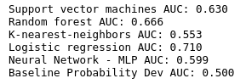
Validation of Baseline Selection on Limited Training Set
When we were building our baseline model for the original submission, we started with a small (10k nobs) randomly selected mini training set so that we could iterate more quickly.
We found that with this small data set, Logistic Regression had the best AUC followed by RF.
We never used the mini training data set again.

Slide 12
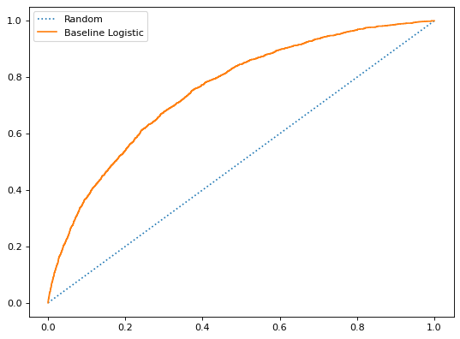
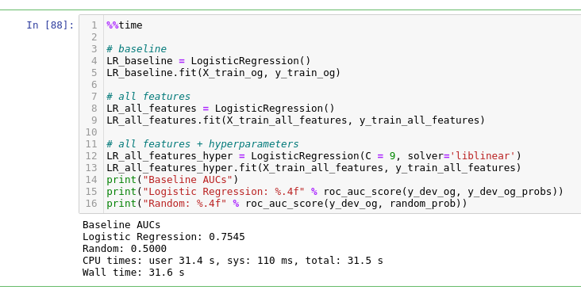
Baseline Model: Logistic Regression
We chose to build on LR as our baseline:
Performed best relative to other classifiers in our original CV run
Relatively quick to train
Very easily interpretable (compared to some other algorithms)
Often used for binary classification successfully
“Sanity check” other model results against a well-known model.
Dev AUC on application_train data: 0.7545
Notes:
We started with a simple logistic regression model on the original dataset. We compare its performance to a simple naive model that randomly assigns to the positive class based on the unconditional probability. We chose the logistic regression as the baseline because it

Slide 13
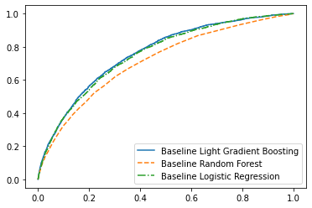
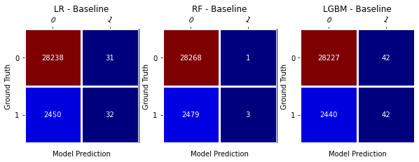
Challenger Models: Random Forest and LightGBM
Random Forest (RF):
An ensemble of randomized decision trees
Allows different constructions of the decision tree model to achieve a more generalized fit
Can take a long time to train depending on hyperparameters
Dev AUC: 0.7124
Light Gradient Boosted Machine (LGBM):
Also an ensemble of decision trees based on GBDT (gradient boosted decision trees)
Introduces GOSS (Gradient-based One-Side Sampling) and EFB (Exclusive Feature Bundling)
GOSS drops examples with small contributions to the cost gradient
EFB bundles mutually exclusive features (think one-hot encoding) that makes training more efficient.
DEV AUC:0.7608

Slide 14

Method 1: Added Data/Feature Engineering
Domain Knowledge:
debt to income ratio, debt to credit ratio
Min, Max, Mean:
min payment, max payment, average payment
Ratios:
total payment divide by debt,
Interaction and Polynomials:
age^2
Fix Incorrect Values:
Set incorrect values to 0 or missing
Flag Anomalies:
Flag suspicious accounts i.e. missing income.
Notes:
Other than typical hot encoding.

Slide 15
Method 2: Balance Classes
Undersampling:
Randomly remove samples with dominant class.
Oversampling
SMOTE
Class Weights
Give extra weight to the minority class in the cost function.

Slide 16
Method 3: Feature Selection
Coefficient Significance
L1 Penalty
Information Gain
Decision Tree
PCA
Incremental PCA (for case of large number of features to prevent MemoryError)

Slide 17
Method 4: Tweaking Hyper-Parameters
Logistic Regression:
Regularization
Class Weight
Random Forest
# of Trees
Min # of Samples Per Leaf
Class Weight
Light GBM
# of Trees
Min # of Samples Per Leaf
Regularization
Class Weight

Slide 18
Evaluating Performance Using Dev Data
Logistic Regression
Random Forest
Light Gradient Boosting
Baseline
0.7545
0.7105
0.7651
New Features
0.7654
0.7209
0.7782
New Features
Hyperparameters
0.7696
0.7654
0.7827 (Best)

Slide 19
Conclusion
With our best model, we were to get ~78% AUC on the test data
The winner of the Kaggle competition got ~81% AUC
Potential Follow-up Research
More error analysis to generate useful features
Include features from more datasets
Develop a stacked model

Slide 20

Thank you!

